Slide 1
“IN THE NAME OF ALLAH THE MOST BENEFICENT THE MOST MERCIFUL”

Slide 2

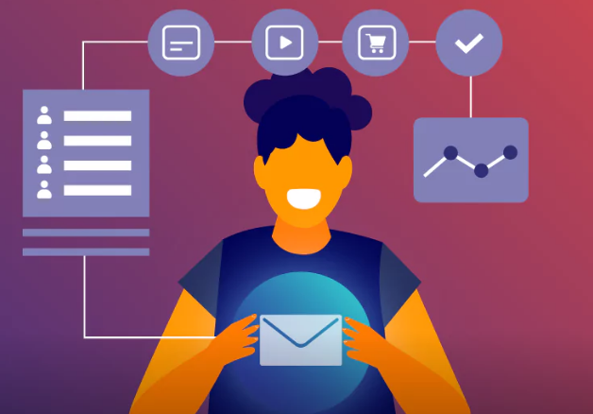
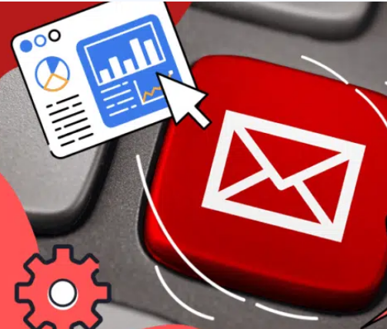


Personalized Email Autonomous Agentic System Email Personalization Outreach Campaign Agent
Gen-AI
Gen-AI
Gen-AI
Gen-AI

Slide 3
Overview
Lack of Proper Engagement due to heavy workload.
Not Delivered customized contents on the emails.
Marketers and suppliers reads the email with the subject’s name, then ignore the email body.
Not enough time for searching the company decision making concerns.
Not enough time to reach the companies, supplier and need to be identify their needs.

Slide 4
PROJECT Flow
Our mission is to develop and deploy multiple AI agents using Crew AI for top-tier email content personalization.
Searching Agent🌐: Real-time internet search to explore websites, like (COMET Estimating LLC) (Any name like Mustafa Shoukat ) and other platforms.
NER Agent: Named Entity Recognition for extracting important information.
Sales Agent 3💼: Expert on our company and its offerings.
Lead Sales Agent🎯: Converts leads into actionable customers, HR, or decision-makers.
Email Writer Agent✉️: Transforms lead data into a personalized, actionable email for HR or decision-makers.

Slide 5
Methodology Used in Project
Front-End Tools and Frameworks:
User Input: Defined through a sleek GUI.
Back-End Tools and Frameworks:
Version Control: Git and VS Code for smooth collaboration.
Backend: Flask to power the engine.
LLMs Configuration: Get those AI brains in gear.
AI Agents: Crew AI to lead the charge.

Slide 6
Outcomes & Output:
Lead Profiles: Detailed profiles highlighting needs and key decision-makers.
Custom Emails: Tailor-made email drafts for targeted outreach.
Increased Conversions: More leads turning into satisfied clients.

Slide 7
Goal and Aim of the Project
AI agents will identify leads, analyze their needs, and craft personalized outreach campaigns to turn interest into action.
A series of personalized email drafts crafted for each lead (Client or Recruiter), addressing their unique needs and aligning with their company culture.

Slide 8
Block Diagram
Version Control
Outreach
(Personalized Email Chatbot)
Agent Real Time
Internet Search
Agent Sale Representative Writer
Agent Lead to client
or decision maker writer
User GUI
Output / Response
LLMs Configuration
Manager Agent
Work Analysis

Slide 9
Benefits of project
This project email personalization chatbot can help you engage customers, boost ROI, and create more meaningful relationships.
Personalized email chatbot make life easier for marketers either; customers respond more positively.
This technique puts full impact on your business, consider Amazon: they generate as much as 35% of their revenue from personalized product recommendations!
This project is a powerful tool for businesses to reach their target audience. Allows brands to deliver relevant messages and also provides invaluable insights into what customers respond to best.

Slide 10
This project is also Helps analyze purchase histories/website visits.
This project also Facilitates in creating personalized emails with product recommendations.
Helps consumers receive content they want to read.Helps gain insights and apparently set the future campaign

Slide 11



HACKATHON TEAM MEMBERS
Mustafa Shoukat
Generative AI Engineer
M Faisal Rasheed
Mechatronics Engineer | Technical writer
Aamir Javed
Technical writer

Slide 12


HACKATHON TEAM MEMBERS
Gule Noor
Civil Engineer | Python developer
Name: Amina
Frontend Developer

